Slide 1


Apache Kafka
an open-source distributed event streaming platform

Slide 2
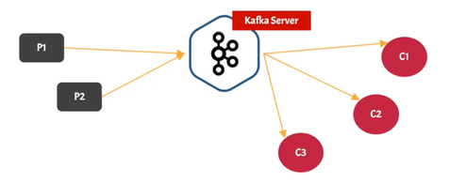
Introduction
Kafka is a messaging system
Kafka Vs Queue (RabbitMQ)

Slide 3
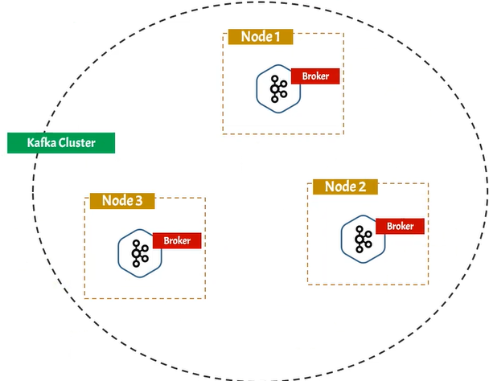
Kafka is distributed application
Referred as Kafka Cluster
A cluster made up of more than one Kafka server
Each Kafka server is called Kafka Broker

Slide 4
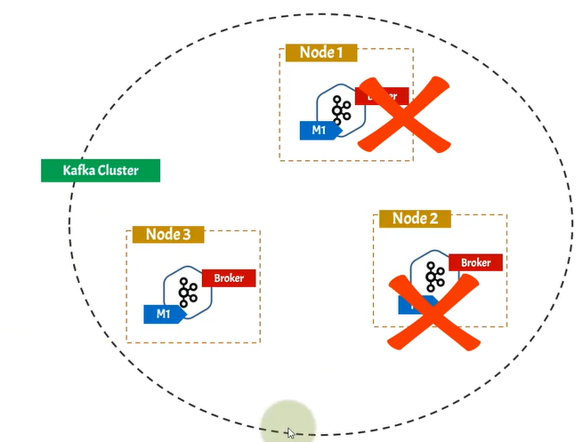
Kafka is fault Tolerant
Ability of system to continue operating even one or more component fails
In Kafka cluster message can be replicated in multiple brokers called Replication Factor

Slide 5
Kafka is scalable system
New Broker can be added anytime
01
Increase number of consumers
02
Kafka can take 1million requests per second
03

Slide 6
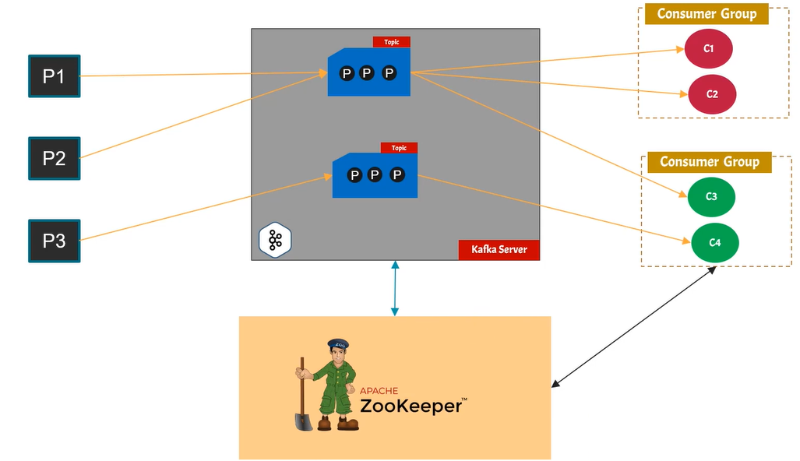
KAFKA Architecture
Kafka Server
Topics
Partition
Publisher/Producer
Consumer Group - consumer
A consumer must be associated with a consumer group
Zookeeper - is a distributed open-source configuration, synchronization service
All the data regarding no: of producers , consumers etc. are stored in zookeeper
Which message has been read by consumer
Cluster information - location ip etc.
Topic configuration

